Slide 1
Spring Boot Series – Day 7
Topic: Spring Boot Logging & Logback Configuration
@CodeByHaindavi | #SpringWithMe

Slide 2
Why Logging is Crucial?
✔️ Logging plays a key role in any real-world backend application. It helps developers understand the flow of execution and troubleshoot issues without having to debug the code directly. ✔️ In production, logs are the only way to know what went wrong when a user reports an error.
✔️ They also help in auditing user actions, monitoring app health, and tracking system behavior over time.
@CodeByHaindavi | #SpringWithMe

Slide 3
Default Logging in Spring Boot
✔️ Spring Boot uses SLF4J as the logging facade, and Logback as the default implementation behind the scenes.
✔️ It automatically configures console logging at the INFO level, so you don’t need to add any extra dependencies.
✔️ All logs by default go to the console and follow a standard format: timestamp, log level, logger, and message.
✔️ No log files are created unless you explicitly configure them.
@CodeByHaindavi | #SpringWithMe

Slide 4
Log Levels
✔️ TRACE: Very detailed logs used for low-level debugging, usually too noisy for regular use.
✔️ DEBUG: Provides more information than INFO, used during development to debug code.
✔️ INFO: General application progress and lifecycle events. This is the default level.
✔️ WARN: Indicates something unexpected happened, but the app is still running fine.
✔️ ERROR: A serious issue occurred. Usually logged when an exception is caught.
✔️ OFF: Used to turn off logging entirely (not recommended for production).
@CodeByHaindavi | #SpringWithMe

Slide 5

Change Log Levels in application.properties
✔️ You can change the logging level globally or for specific packages/classes using the application.properties or application.yml file.
✔️ This makes logs more focused and helps debug specific components without cluttering the output.
@CodeByHaindavi | #SpringWithMe

Slide 6
Logback Overview
✔️ Logback is the default logging framework used in Spring Boot. It is fast, flexible, and supports advanced configurations.
✔️ You can use either logback.xml or the recommended logback-spring.xml for configuring log behavior.
✔️ Logback supports different appenders (ConsoleAppender, FileAppender), pattern layouts for formatting logs, and conditional logic based on Spring profiles (like dev vs prod).
@CodeByHaindavi | #SpringWithMe

Slide 7
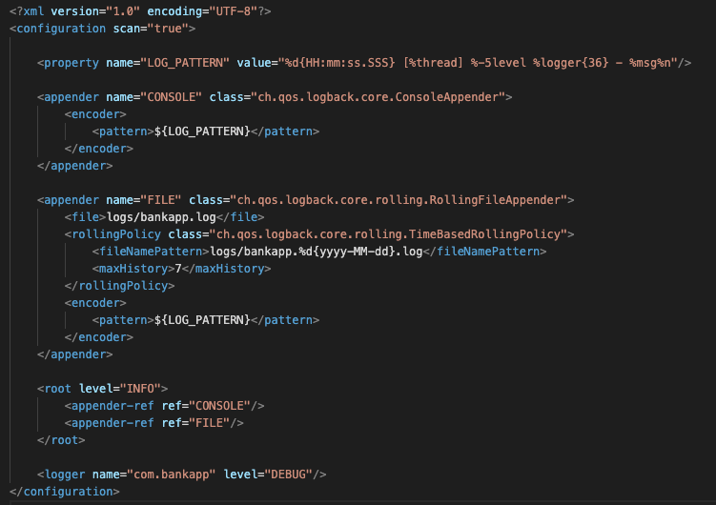
Basic Logback Configuration Example
✔️ This logback-spring.xml configuration sets up structured logging with a custom timestamped format, outputs logs to both the console and a rolling file, and retains logs for 7 days.
✔️ It sets the default logging level to INFO, while enabling more detailed DEBUG logs for a specific package.
@CodeByHaindavi | #SpringWithMe

Slide 8

File Logging Setup
✔️ Spring Boot can also log to files. This is useful in production where you need to retain logs over time.
✔️ To enable file logging, just add this to application.properties:
✔️ It keeps environment-specific logic clean, safe, and easy to switch — without touching any business code.
✔️ Spring will automatically create the file and rotate it by default to manage size and age.
@CodeByHaindavi | #SpringWithMe

Slide 9
Profile-Specific Logging (Dev vs Prod)
✔️ You can define separate log behaviors for different environments using the <springProfile> tag in logback-spring.xml.
Example:
<springProfile name="dev"> logs only to console
<springProfile name="prod"> logs to file with rotation
✔️ This helps keep development logs clean and ensures production logs are archived and retained properly.
@CodeByHaindavi | #SpringWithMe

Slide 10
Log Patterns Explained
✔️ Logback allows pattern customization to control how logs appear.
✔️ Common pattern tokens:
%d{HH:mm:ss} - Timestamp
%level - Log level (INFO, DEBUG, etc.)
%logger{36} - Logger name (usually class)
%msg - Actual log message
%n - New line
✔️ Using a readable and consistent pattern improves developer productivity when reading logs.
@CodeByHaindavi | #SpringWithMe

Slide 11
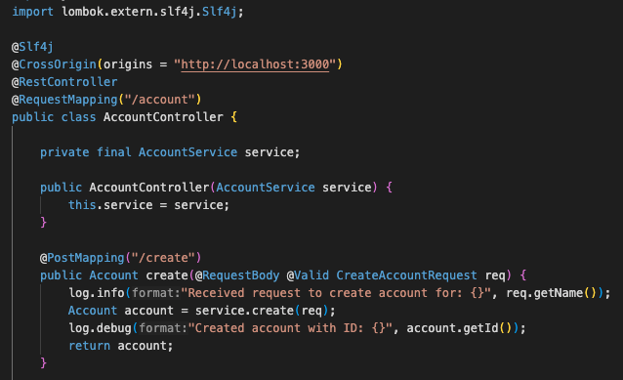
Using SLF4J with Lombok
✔️ Instead of writing boilerplate logger code, use Lombok’s @Slf4j annotation.
✔️ It automatically injects a static logger named 'log' into your class.
@CodeByHaindavi | #SpringWithMe

Slide 12
📌 Hands-On Tip
✔️ Never log sensitive data like passwords or tokens.
✔️ Use DEBUG only during development and INFO/WARN in production.
✔️ Structure your log messages for clarity: include key context like user ID or transaction ID.
✔️ Don’t over-log — focus on meaningful checkpoints.
✔️ Rotate and archive logs regularly using logback configuration or a log management system like ELK or Splunk.
@CodeByHaindavi | #SpringWithMe

Slide 13
💼 Interview Insight
How do you configure file-based logging in a Spring Boot application?
• By creating a logback-spring.xml file and defining a RollingFileAppender with a TimeBasedRollingPolicy. This allows logs to be written to files and rotated based on time or size.
2. What’s the difference between INFO and DEBUG levels in logback, and when would you use each?
• INFO is used for general application events, while DEBUG is for detailed internal flow helpful during development. Use DEBUG locally and INFO or higher in production.
Why is logback-spring.xml preferred over logback.xml in Spring Boot?
• logback-spring.xml allows Spring Boot to read and override properties using Spring’s environment and profile support, which isn’t possible with logback.xml.
@CodeByHaindavi | #SpringWithMe

Slide 14
📌 Recap – Day 7
✔️ Spring Boot uses SLF4J + Logback by default for logging.
✔️ You can control log levels and output using application.properties or logback-spring.xml.
✔️ Use proper log levels and patterns, avoid sensitive data, and configure file logging for production.
✔️ Logging is not just for debugging — it’s your window into the running system.
👉 Coming up next: Validation & Global Exception Handling in Spring Boot
@CodeByHaindavi | #SpringWithMe

